Slide 1
CSE 4101
Lecture 2
Knowledge: General Concepts

Slide 2
Definition of Knowledge
Definition :Knowledge is a familiarity, awareness, or understanding of someone or something, such as facts (a thing that is known or proved to be true.), information, descriptions, or skills, which is acquired through experience or education by perceiving (become aware or conscious of something),, discovering, or learning.

Slide 3
Definition of Knowledge-Cont 1
While these definitions may be true but it is far from complete. In fact knowledge is much more than this. It is having a familiarity with language, concepts, procedures, rules, ideas, thoughts, places, customs, facts and associations, coupled with an ability to use these notations effectively in modeling different aspects of the world. Without this ability, the facts and concepts are meaningless.

Slide 4
Definition of Knowledge-Cont
The meaning of knowledge is closely related to the meaning of intelligence. Intelligence requires the possession of and access to knowledge. And a characteristic of intelligent people is that they possess much knowledge.

Slide 5
Definition of Knowledge-Cont
Knowledge consists of facts, concepts, rules
o Fact is something that is true or something that has occurred or has been proven correct. An example of a fact is that the world is round.

Slide 6
Definition of Knowledge-Cont
o Concept is an idea of what something is or how it works.
Example: ”She is familiar with basic concepts of psychology.”
o Rule is one of a set of explicit or understood regulations or principals governing conduct or procedure within a particular area of activity. Example: “the rules of cricket ”

Slide 7
Organization of Knowledge
In biological organisms
• Knowledge is stored as complex structures of interconnected neurons.
• The structure corresponds to symbolic representations of the knowledge possessed by the organism, the facts rules and so on.
• The average human brain weights about 3.3 pounds and contains an estimated number of 1012 neurons.
• The neurons and their interconnection capabilities provide about 1014 bits of potential storage capacity.

Slide 8
Organization of Knowledge
In computer
• Knowledge is stored as complex structures of interconnected neurons.
• The neurons and their interconnection capabilities provide about 1014 bits of potential storage capacity.
Note: The gap between human and computer storage capacities is narrowing rapidly. Unfortunately, there is still a wide gap between representation schemes and effectiveness.

Slide 9
Representation of Knowledge in the form of Written Language
A common way to represent knowledge external to a computer or a human is in the form of written language.
For example, some facts and relations represented in printed English are
Joe is tall.
Bill loves Sue
Sam has learned to use recursion to manipulate linked lists in several programming language.

Slide 10
Representation of Knowledge in the form of Written Language
The first item of knowledge above expresses a simple fact, an attribute possessed by a person.
The second item expresses a complex binary relation between two persons.
The third item is most complex, expressing relations between a person and more abstract programming concepts.

Slide 11
Declarative Knowledge and Procedural Knowledge
Knowledge may be declarative or procedural.
Procedural knowledge is compiled knowledge related to the performance of some task. For example, the steps used to solve an algebraic equation are expressed as procedural knowledge.

Slide 12
Declarative Knowledge and Procedural Knowledge
Declarative programming is where you say what you want without having to say how to do it.
With procedural programming, you have to specify exact steps to get the result.

Slide 13
Example of Procedural language
It's basically “how” you know to do something. The classic example of procedural knowledge is riding a bicycle. When someone was teaching you how to ride a bicycle, no matter what they said, you probably struggled to grasp it until you'd actually done it a few times Declarative programming is where you say what you want without having to say how to do it.

Slide 14
Example of Declarative language
Declarative knowledge is the knowledge of facts, data, and pieces of information, such as mathematical or scientific facts. An example of a declarative knowledge statement is, "A car has four tires." Declarative knowledge is explicit, meaning either a person knows it or they don't.

Slide 15
Heuristic Knowledge
Heuristic knowledge is a special type of knowledge used by humans to solve complex problems.
Heuristics are the knowledge used to make good judgments, or the strategies, tricks, or “rules of thumb” used to simplify the solutions or problems.
Heuristics are acquired with much experience. Declarative

Slide 16
Heuristic Knowledge
For example, in locating a fault in a TV set, an experienced technician will not start by making numerous voltage checks when it is clear that the sound is present but the picture is not, but instead will immediately reason that the high voltage flyback transformer or related component is the culprit. This type of reasoning may not be correct, but it frequently is, and then it leads to a quick solution. Heuristic knowledge is a special type of knowledge used by humans to solve complex problems.

Slide 17
Heuristic Knowledge
For example, in locating a fault in a TV set, an experienced technician will not start by making numerous voltage checks when it is clear that the sound is present but the picture is not, but instead will immediately reason that the high voltage flyback transformer or related component is the culprit. This type of reasoning may not be correct, but it frequently is, and then it leads to a quick solution.Heuristic knowledge is a special type of knowledge used by humans to solve complex problems.

Slide 18
Difference between data and knowledge
Knowledge should not be confused with data.
Feigenbaun and MaCorduck (1983) emphasize the difference with the following examples.
A physician treating a patient uses both knowledge and data. The data is the patient’s record, including patient history, measurements or vital signs, drugs given, response to drugs and so on. Whereas the knowledge is what the physician has learned in medical school and the years of internship, residency, specialization and practice. Knowledge is what the physician now learns in journals. It consists of facts, beliefs, and most importantly, heuristic knowledge.

Slide 19
Difference between belief, hypothesis and knowledge
Belief can be defined as essentially any meaningful and coherent expression that can be represented. Thus, a belief may be true or false.
Hypothesis is defined as a justified belief that is known to be true. Thus, a hypothesis is a belief which is backed up with some supporting evidence. But it may still be false. In other words, it is a preliminary assumption or tentative explanation that accounts for a set of facts, taken to be true for the purpose of investigating and testing.
Finally we define knowledge as true justified belief.

Slide 20
Epistemology
Epistemology is the philosophical study of the nature, origin, and limits of human knowledge. The term is derived from the Greek epistēmē (“knowledge”) and logos (“reason”), and accordingly the field is sometimes referred to as the theory of knowledge. Epistemology is the theory of knowledge.

Slide 21
Metaknowledge
Metaknowledge is knowledge about knowledge, that is, knowledge about what we know. Meta-knowledge includes information about the knowledge the system possesses, about the efficiency of certain methods used by the system, the probabilities of the success of past plans, etc. The meta-knowledge is generally used to guide future planning or execution phases of a system.

Slide 22
Example of Epistemology
Legal Affairs. Epistemology plays a prominent role in the production of knowledge in legal affairs. ...
Changing the Password. ...
Security Issues. ...
Scientific Discoveries. ...
Decision Making. ...
Critical Thinking. ...
Confirming the Existence of Extraterrestrial Life. ...
Validating News.

Slide 23
Knowledge Based Systems
A knowledge-based system (KBS) is a form of artificial intelligence (AI) that aims to capture the knowledge of human experts to support decision-making. Examples of knowledge-based systems include expert systems, which are so called because of their reliance on human expertise.

Slide 24
Knowledge Based Systems
Knowledge-based systems typically have three components, which include:
Knowledge Base: A knowledge base is an established collection of information and resources. The system uses this as its repository (source) for the knowledge it uses to make decisions.
Inference engine: An inference engine processes data throughout the system. It acts similarly to a search engine within the system by locating relevant information based on the requests.

Slide 25
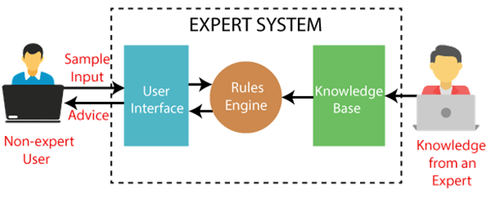
Knowledge Based Systems
User interface: The user interface is how the knowledge-based system appears to users on the computer. This allows users to interact with the system and submit requests.

Slide 26
Types of knowledge-based systems
Case Based Reasoning
Case-based systems use case-based reasoning. This involves reviewing past knowledge of similar situations. Based on what it finds, the knowledge-based system provides solutions that were effective in those given situations.

Slide 27
Types of knowledge-based systems
Case Based Reasoning
Case-based reasoning means using old experiences to understand and solve new problems. In case-based reasoning, a reasoner remembers a previous situation similar to the current one and uses that to solve the new problem.

Slide 28
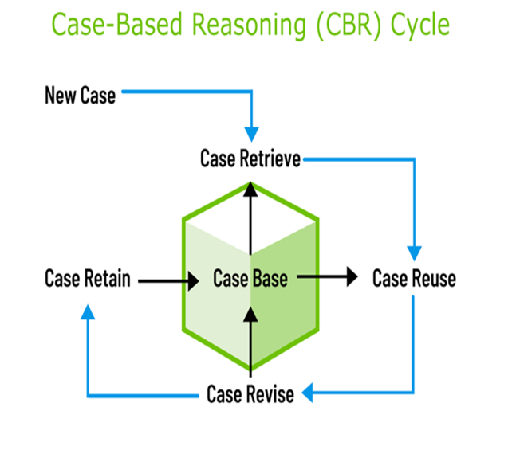
Case Based Reasoning

Slide 29
Expert systems (1)
Those who possess knowledge are called expert .
An expert is a skillful person who can do things other people cannot,
Expert systems are one of the most common types of knowledge-based systems. These systems mimic human experts' decision-making processes, making them helpful for complex analyses, calculations and predictions. In addition to presenting solutions, they provide specific explanations for the problems they're solving.

Slide 30
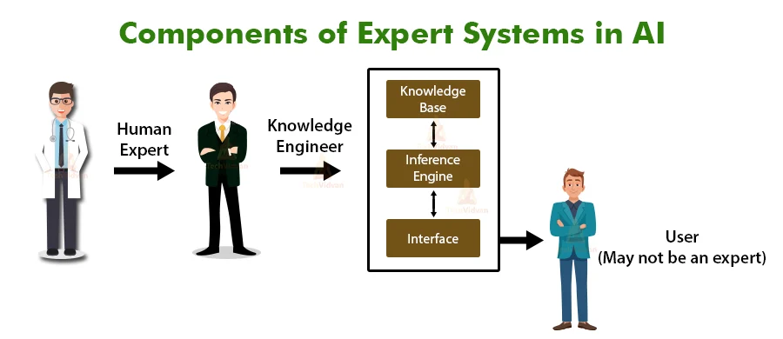
Expert systems (2)

Slide 31
Rule Based Systems
The human mental process is internal, and it is too complex to be represented as an algorithm.
Most experts are capable of expressing their knowledge in the form rules for problem solving.
IF the ‘traffic light’ is green
THEN the action is go
IF the ‘traffic light’ is red
THEN the action is stop

Slide 32
Rule Based Systems
In AI, rule is the most commonly used type of knowledge representation.
A rule can be defined as an IF-THEN structure that relates given information or facts.
In the IF part to some action in the THEN part.
A rule provides some description of how to solve a problem.
Rules are relatively easy to create and understand.

Slide 33
Rule Based Systems
Rule-based systems rely on human-made, hard-coded rules. It uses these rules to analyze and manipulate data to achieve specific outcomes. This may involve using IF-THEN rules, which establish that if a user makes a certain request, then the system delivers a certain outcome.

Slide 34
Rule Based Systems
Any rule consists of two parts : the IF part, called the antecedent (premise or condition) and the THEN part called the consequent (conclusion or action) .
IF <antecedent>
THEN <consequent>

Slide 35
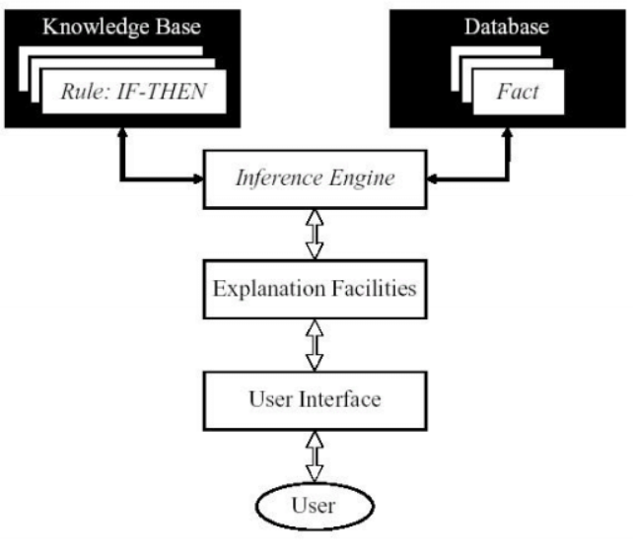
Rule Based Systems
(Inference: Interpretation)

Slide 36
Turing Test
The Turing Test is a deceptively simple method of determining whether a machine can demonstrate human intelligence: If a machine can engage in a conversation with a human without being detected as a machine, it has demonstrated human intelligence.
The Turing Test was proposed in a paper published in 1950 by mathematician and computing pioneer Alan Turing. It has become a fundamental motivator in the theory and development of artificial Intelligence (AI).

Slide 37
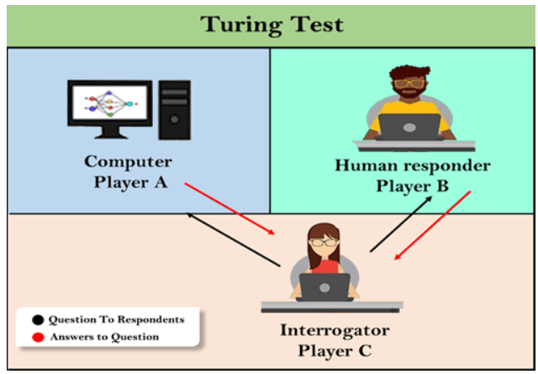
Turing Test
The Turing test is based on a party game "Imitation game," with some modifications. This game involves three players in which one player is Computer, another player is human responder, and the third player is a human Interrogator, who is isolated from other two players and his job is to find that which player is machine among two of them.

Slide 38
Turing Test
Consider, Player A is a computer, Player B is human, and Player C is an interrogator. Interrogator is aware that one of them is machine, but he needs to identify this on the basis of questions and their responses. The conversation between all players is via keyboard and screen so the result would not depend on the machine's ability to convert words as speech.
The test result does not depend on each correct answer, but only how closely its responses like a human answer. The computer is permitted to do everything possible to force a wrong identification by the interrogator.

Slide 39
Turing Test
In this game, if an interrogator would not be able to identify which is a machine and which is human, then the computer passes the test successfully, and the machine is said to be intelligent and can think like a human.
"In 1991, the New York businessman Hugh Loebner announces the prize competition, offering a $100,000 prize for the first computer to pass the Turing test. However, no AI program to till date, come close to passing an undiluted Turing test".

Slide 40
End

